Slide 1

Pharmachain: A Closed-Loop Relational System for Pharmaceutical Traceability
MCA Semester II Project | High-Complexity Database Design

Slide 2
PROJECT DEFINITION
The Project "What"
Core System
Operational Scope
Unique Value
A 3NF-normalized relational database designed to manage the mid-stream pharmaceutical supply chain with complete traceability.
Tracking operations between the factory gate and retail pharmacy counter(mid-stream), capturing every movement and transaction.
Self-aware database utilizing temporal triggers to automate reverse logistics management for expired and recalled pharmaceutical goods.

Slide 3
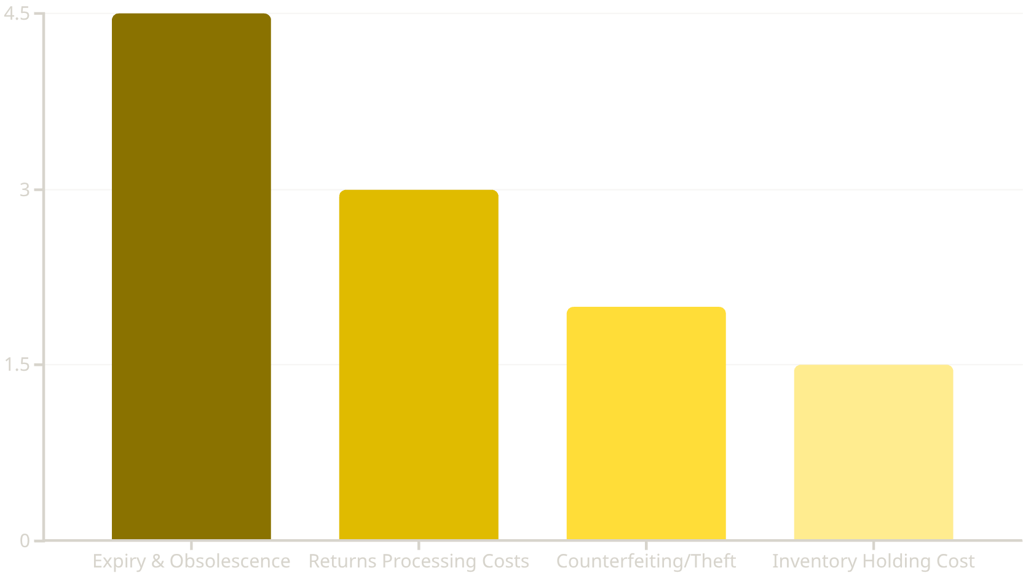
Revenue Leakage in Pharmaceutical Supply Chains
Understanding the Losses
This chart illustrates key areas of revenue leakage within the pharmaceutical supply chain. Expiry & Obsolescence, accounting for 4.5% of total revenue, represents the largest single area of loss.
This significant percentage highlights a critical inefficiency, making it the primary target area for PharmaChain's intervention. Our system aims for a potential 40% recovery in this category through automated reverse logistics and enhanced traceability.
Other substantial losses include Returns Processing Costs, Counterfeiting/Theft, and Inventory Holding Costs, all contributing to the overall ~11% annual revenue impact.
Source: Industry estimates on Reverse Logistics inefficiencies (Narayana et al., 2014; PMC Case Studies). Total impact: ~11% of annual revenue.

Slide 4
SYSTEM ARCHITECTURE
The Architectural Modules
36-Table 3NF-Normalized Relational Schema
Identity & Governance
Smart Warehousing
Reverse Logistics & Compliance
Organizations
Locations
User_Accounts
Access_Roles
Contact_Directory
System_Audit_Log
Warehouses
Storage_Zones
Stock_Ledger
Inventory_Adjustments
Temperature_Logs
Quarantine_Hold
Return_Authorizations
Return_Shipping
Inspection_Reports
Disposal_Certificates
Credit_Notes
Recalled_Batches
Manages user access, organizational hierarchy, and system activity logging for security and accountability.
Manages physical inventory locations, stock levels, adjustments, and environmental conditions, including quarantine.
Facilitates product returns, inspections, secure disposal, and management of recalled batches, ensuring compliance.
Product & Batch Intelligence
Forward Fulfillment
Financial & Analytics
Medicines
Drug_Categories
Batches
Secondary_Packaging
Manufacturing_Orders
Quality_Certificates
Sales_Orders
Order_Line_Items
Shipments
Shipment_Tracking
Carrier_Fleet
Proof_of_Delivery
Invoice_Records
Payment_Ledger
Cost_Allocation
Revenue_Recognition
Batch_Profitability
Compliance_Metrics
Catalogs product details, tracks batches through manufacturing, and manages quality certifications.
Handles sales order processing, shipment logistics, tracking, and final proof of delivery to retailers.
Processes financial transactions, tracks costs and revenues, and generates key compliance and profitability metrics.

Slide 5

RESEARCH FOUNDATION
Evidence-Based Design
PMC7868907: Closed-Loop Analysis
PMC6706717: Traceability Standards
We applied the Decision-Making Trial and Evaluation Laboratory approach to systematically identify critical barriers in reverse logistics operations.
Incorporated state-of-the-art traceability concepts for recalling defective pharmaceutical products across complex supply networks.
This methodology informed our database design decisions, particularly in structuring the return request and quarantine workflows.
Our central Batch Pedigree table solves the "information asymmetry" problem by connecting every stakeholder with real-time visibility.

Slide 6

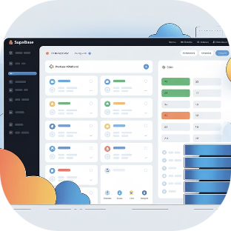
INFRASTRUCTURE
Our Progress & Collaborative Stack
GitHub Version Control
Supabase PostgreSQL
SQL schema development managed through pull requests, enabling collaborative logic verification and code review across the entire team.
Shared, real-time cloud database instance allowing all six team members to build and query simultaneously across environments.

Slide 7



Project Phasing & Progress Trajectory
Completed ✅
In Progress 🚧
Future Scope 🚀
Foundation & Architecture
The Closed-Loop Core
AI & Smart Integration
Established DevOps workflow (GitHub + Supabase Cloud)
Defined 30-table 'Mid-Stream' Schema
Implemented Role-Based Access Control (RBAC)
Implementation of 3NF Relational Database
Coding the 'Reverse Logistics' & 'Disposal' modules
Deploying Temporal Triggers for Auto-Expiry
Integration of Python-based ML models
Smart Demand Forecasting based on return rates
Anomaly detection for counterfeit tracking

Slide 8
CONCLUSION
PharmaChain: Closing the Loop
Audit Trail Excellence
Financial Impact
Public Health Protection
Bulletproof traceability from factory gate to pharmacy counter and back, ensuring medicine safety at every step.
Minimizing pharmaceutical losses through proactive expiry management and efficient recall processes.
Reducing the risk of expired or recalled medications reaching consumers through automated temporal monitoring.
A research-grade database system that transforms pharmaceutical supply chain management from reactive to proactive, protecting both revenue and patient safety.

